Slide 1
HYDROGRAPHIC SERVICES REVIEW PANEL Stakeholder Panel: Alaska Regional Needs for NOAA’s Navigation Services U.S. Army Corps of Engineers
Stephen C. Boardman
Chief, Civil Project Management Branch
U.S. Corps of Engineers, Alaska District
Anchorage, Alaska
23 May 2012

Slide 2
HISTORY
The Corps of Engineers has been developing and constructing navigational improvements in Alaska since 1912. The first project was improving the Apoon Mouth of the Yukon. The first permanent project was Nome Harbor which was started in 1916.
Since then the Corps has constructed 49 harbors and 15 channels. The Corps maintains the General Navigation Features (breakwaters, entrance channels, and maneuver channels) for each of the projects.
Currently, two harbors (Unalaska and Akutan) are under construction while we are improving another (Douglas).
Notes:
The first navigational project the Corps conducted was the removal of obstructions and boulders from the Apoon Mount of the Yukon River in 1912. The first permanent construction structure was the establishment and dredging of a navigational channel and mooring basin within the Snake River at Nome. Since that time the Corps has constructed 49 harbors and 15 navigational channels. We also have 3 current navigation construction projects – 2 are for new harbors (Unalaska and Akutan) and improving an existing harbor (Douglas Harbor at Juneau).

Slide 3
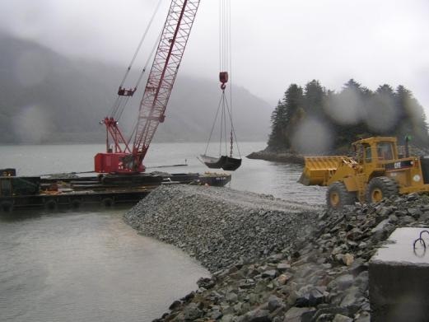
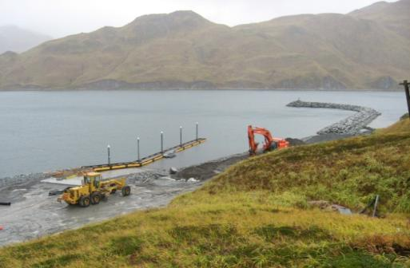
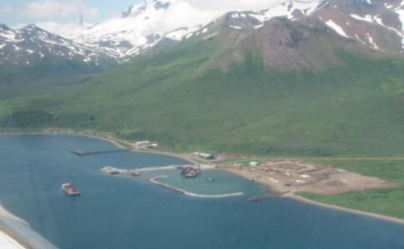
Marine transportation successes
Constructed Harbor Projects or Phases
 | Project Cost ($000) | Basin Size (acres) | Approx # of Vessels Accommodated
Unalaska Hbr – Phase 1 | 8,900 | 16.8 | 75
Douglas Hbr – Phase 1 | 4,300 | 5.5 | 72
False Pass Harbor | 23,000 | 5.2 | 88
Saint Paul Harbor | 21,000 | 3.3 | 60
Unalaska Harbor
Douglas Harbor
False Pass Harbor
Notes:
Recently we completed Phases 1 at the new Carl Moses Harbor in Unalaska (rubblemound breakwater, launching ramp, and dredging) and at Douglas Harbor (rubblemound breakwater). We also completed a new harbor at False Pass and a small boat basin inside the larger St. Paul Harbor.

Slide 4
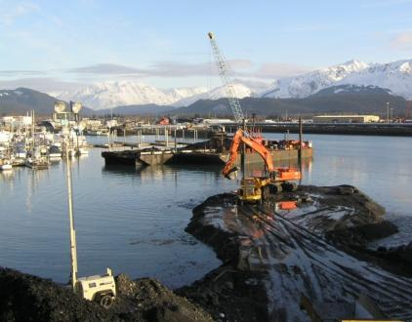
Marine transportation successes (Cont.)
Constructed Harbor Projects or Phases
 | Project Cost ($000) | Basin Size (acres) | Approx # of Vessels Accommodated
Chignik Harbor | 8,800 | 4.8 | 70
Seward Breakwater Extension | 4,164 | 11.7 | 346
Seward Breakwater Extension
Notes:
Two other recent construction projects were the creation of harbor at Chignik and the extension of the main rubblemound breakwater (215 LF) at Seward.

Slide 5
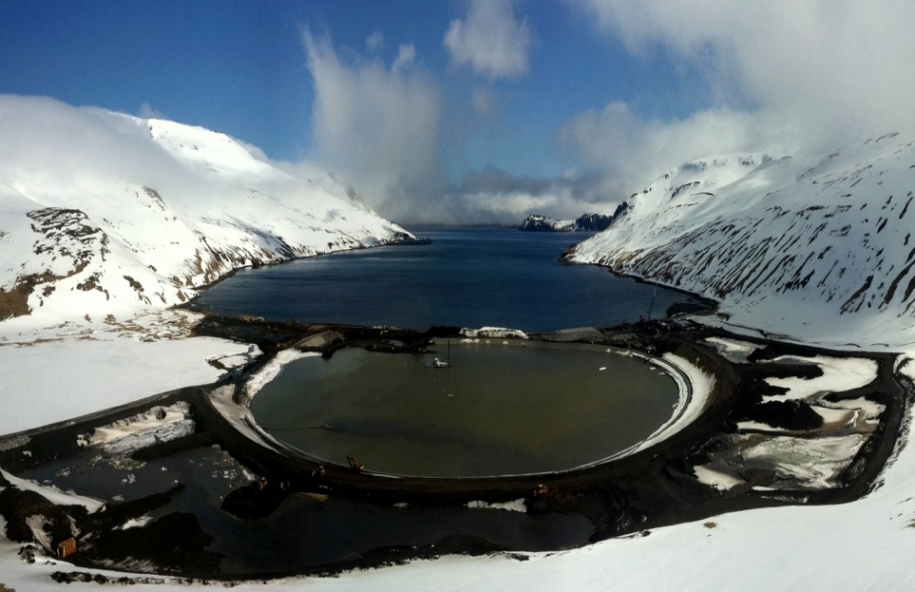
Marine transportation Success Stories
Ongoing Construction Projects
 | Project Cost ($000) | Basin Size (acres) | Approx # of Vessels Accommodated
Akutan Harbor | 31,897 | 14.9 | 58
Douglas Floating Breakwater – Phase 2 | 1,770 | See Previous Slide
Unalaska Floating Breakwater – Phase 2 | 12,526 | See Previous Slide
Akutan Harbor Site
Notes:
As I referred to earlier, we are working on Phases 2 at Unalaska (floating breakwaters) and Douglas Harbor (also a floating breakwater). Finally Akutan Harbor is in its 3rd year of a three contract.

Slide 6
Future Navigational Improvements
Projects in Design
Haines Harbor Expansion
Valdez Harbor
Port Lions (on hold pending funding)
Notes:
While we have several ongoing navigation studies, these three projects are in the Plans and Specification Phase of design.

Slide 7
Marine transportation success stories
Data Collection and Analyses
Western Alaska Hindcast Study
Western Alaska Storm-Induced Water Level Prediction
Alaska Ocean Observing System (AOOS)
Multi-agency Initiative: DEC, F&G, DNR, Universities, USGS, USCG, Corps, USFWS, USFS, BOEMRE, and others
Building network of observation platforms and forecast models
Coordinating planning and engineering efforts
State coastal engineers, University of Alaska, U.S. Navy
Notes:
Over the past few years we have been able to secure funds that allowed us to obtain wind and wave data and enter that data to enter into models that will allow us to predict wave conditions and storm surge ocean elevations. This allows us to design future shore protection works.
We are also interacting and collaborating with other agencies and groups on engineering data, forecasting of environmental conditions, and how to respond to changes in the environment due to changes in the climate.

Slide 8
Corps of Engineer Needs for NOAA’s Services, Products, & Information
a. Uses and Applications
Operations and Maintenance
New Project Planning and Design
Wave and Wind data
Tidal datum
Hydrographic Surveys

Slide 9
Corps of Engineer Needs for NOAA’s Services, Products, & Information
b. Data Gaps or Issues
Redundancy on each agency’s part (surveys and tide gauges)
Lack of Wave and Wind data
Lack of Tidal datum
Lack of current Hydrographic Surveys

Slide 10
Corps of Engineer Needs for NOAA’s Services, Products, & Information
c. Recommendations For Improvements In The Relationship
Communications:
User Groups (ex. – Alaska Interagency Hydrographic Survey Work
Standardization of data for useful products (digital sounding sets)
Collaboration on S-57 products. The Corps still uses .pdf

Slide 11
Alaska Regional Ports Study
FFY 2003 -- Reconnaissance level study commenced. Purpose: To determine if there was a Federal interest in participating in cost shared feasibility studies addressing regional ports and harbors throughout the State of Alaska.
Harbors are part of a system (not individual community needs) and as such they need to be analyzed and justified as a system.
Study was to be a systematic analysis of existing and future needs for harbors and navigational systems.
Coastal Alaska was divided into regions: Southeast, Southcentral, Aleutians, Yukon-Kuskokwim, and Northwestern/Northern Regions.
Notes:
The justification process for Corps projects looked at individual projects and their specific merits. As a result, neighbors competed with each other for the needs for navigational improvements and for the “benefits” to be derived by any improvements. However, the Corps now realizes, and in particular after the events of Hurricanes Katrina and Rita, plus more recently the flooding along the rivers of the Greater Mississippi River Valley, that all of the projects are really part of a larger system. As such we need to start looking at justifying projects in a systematic manner. So in Federal Fiscal Year (FFY) 2003 the Corps started a reconnaissance level study of navigational needs for the entire State of Alaska.

Slide 12
Alaska Regional Ports Study
January 2008 -- 1st Alaska Regional Ports Conference. Hosted by Alaska State Department of Transportation and Corps of Engineers. Purpose: To gain knowledge on the needs for navigational improvements prior to the conclusion of the Reconnaissance (905(b)) Report. Over 125 attendees.
Overwhelming Mandate – The need for ongoing collaboration, comprehensive planning and leadership.
Develop a comprehensive ports and harbor plan for Alaska.
May 2008 -- Corps published the 905(b) Report.
September 2009 -- State of Alaska and Corps of Engineers entered into a cost shared Feasibility Study to establish baseline information needed for a statewide plan. The following items were commissioned:
Strategic Trends Analysis
Hub Analysis
Projects Needs List
Policy Recommendations
Identify locations of potential construction materials (ex., rock)
Notes:
The study was to conduct a systematic analysis of the existing and future needs for navigational improvements. Given the size and magnitude of the State of Alaska, we broke the State into smaller Regions. Again given the largeness of the State, we identified the State of Alaska as a logical potential partner to conduct these studies.
In January 2008, in partnership with the State of Alaska's Department of Transportation and Public Facilities, the Corps hosted the first Alaska Regional Ports Conference. The overwhelming mandate from the 125 participants was that there was a need for ongoing collaboration, comprehensive planning and leadership from all agencies but in particular between the State and the Corps. The participants also strongly believed that the exisitng Statewide Transportation Plan needs to be modified by expanding the marine aspects of the plan.

Slide 13
Alaska Regional Ports Study
November 2010 – 2nd Statewide Alaska Regional Ports and Harbors Conference. 150+ attendees.
Reviewed the projects lists by region, identified selection criteria for investment, and ranked projects by priority.
Immediate interest by Congressional Delegation and Governor to conduct a subordinate study -- an Arctic Deep Draft Ports Study.
Goal – Identify and locate potential sites for an arctic deep water (draft) port(s).
To do that, we needed to identify criteria for an arctic deep draft harbor :
What is required? - Depth, moorage capacity, upland infrastructure, intermodal transportation requirements, etc.
Who are the potential users?
Where is the arctic?
Conducted a “Planning Charrette” in May 2011.
Notes:
The Corps completed the Reconnaissance report in May 2008. From there the State of Alaska and the Corps of Engineers enterred into a cost shared agreement to conduct feasibility level studies. The first items commissioned were:
A Strategic Trend Analysis
A Hub analysis to determine where are the logical central locations within the various regions on where commerce is conducted
Identify all of the navigational needs regardless of size and what agency might be responsible to develop that need.
Any recommendations on modifying policy that would improve the development of navigational projects
And where are there potential sources of construction materials (primarily rock) that could be used for construction

Slide 14
May 16-17, 2011 planning charrette
State Government
Governor Parnell requested funding for a 3-year Arctic Ports Study to support a deep draft port (minimum of -35 feet depth) and economic development in Alaska.
Federal Government
The Alaska Congressional delegation sponsored legislation highlighting the need for U.S. Arctic ports to support national sovereignty, environmental stewardship and life safety.

Slide 15
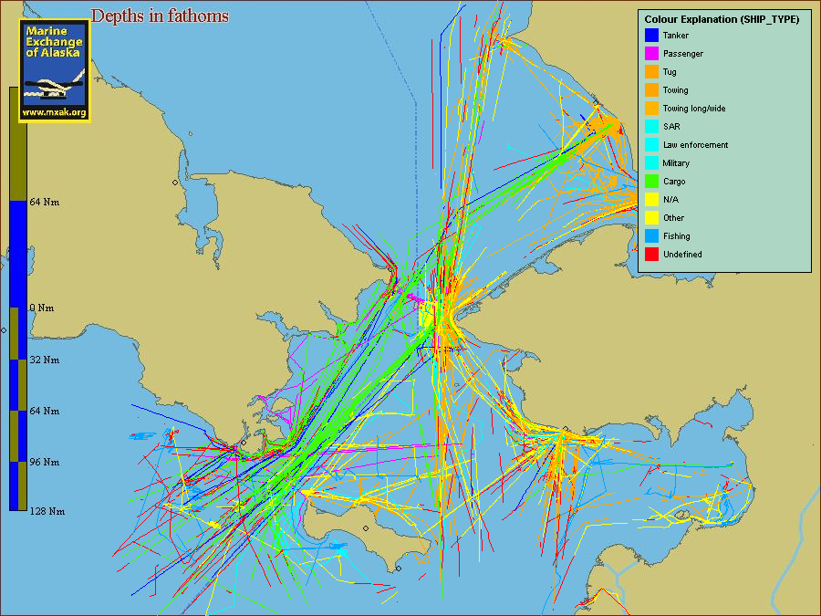
Arctic marine traffic is increasing

Slide 16
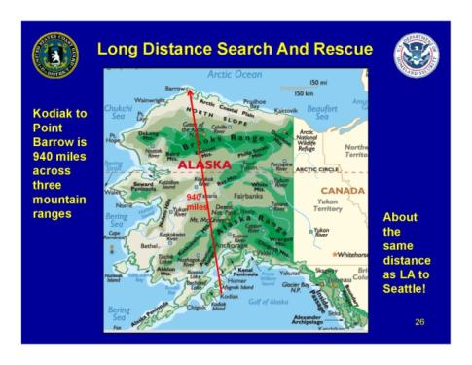
Panel #1 – Federal Interests

Slide 17
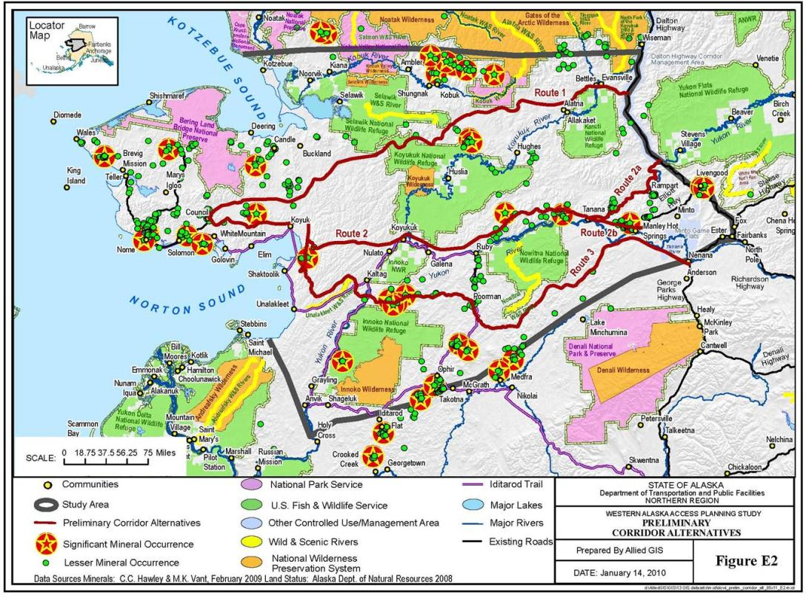
Panel #2 – State Interests

Slide 18
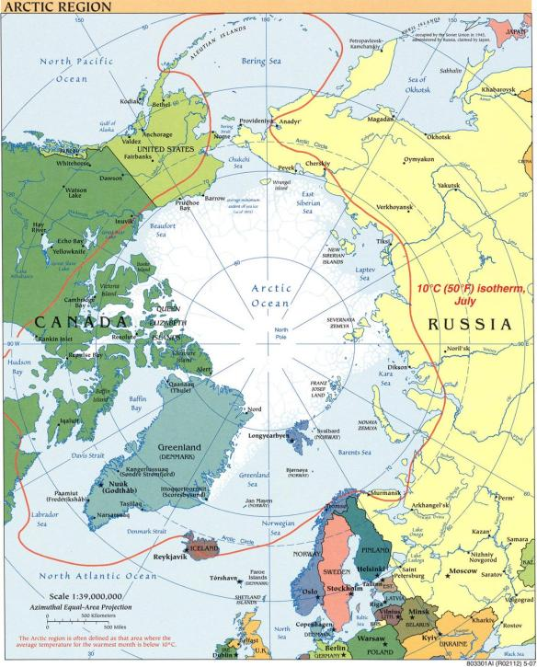
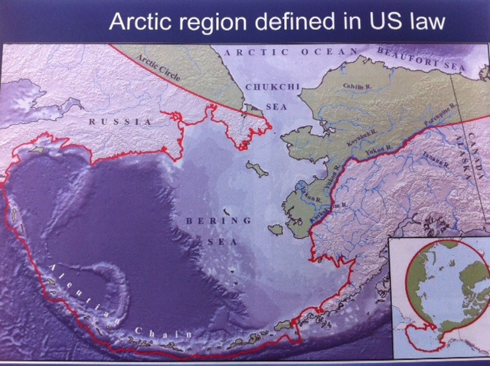
Breakout #1 - Define Arctic Geography

Slide 19
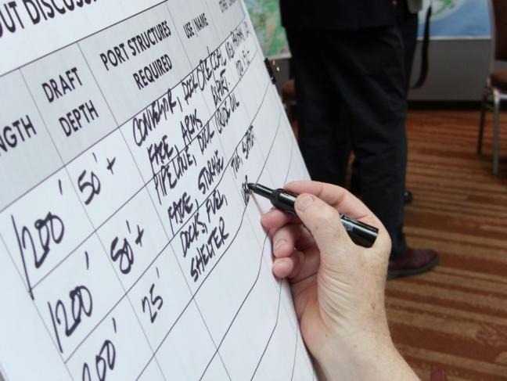
Breakout #2 - Define Vessel Parameters
Diverse vessels types
Desired depth 20-50’
Increased traffic
SAR
Life safety
Spill response
Need tugs
Port infrastructure lacking

Slide 20
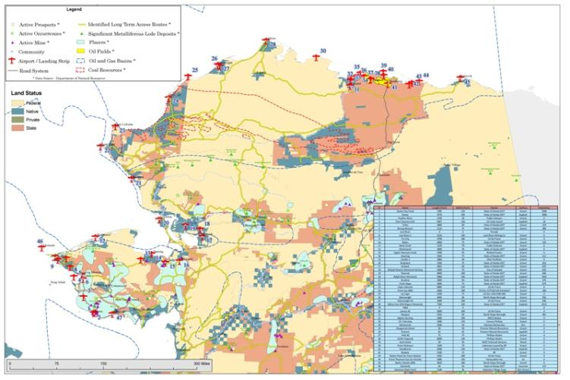
Breakout #3 - Port Siting
No one port solution
Need port marine and upland facilities
Partnerships necessary
Federal
State
Local
Resource development and industry

Slide 21
Potential Ports Sites to be Evaluated
St. Paul Island
St. Lawrence Island
Port Clarence (Nome/Teller)
Cape Blossom (Kotzebue)
Mekoryuk (Nunivak Island)
Cape Thompson (Point Hope)
Wainwright
Point Franklin
9. Barrow
10. Prudhoe Bay
11. Mary Sachs Entrance
12. Bethel
13. Emmonak
14. Cape Darby
Nome
Others TBD
Most Sites Identified in Northern Waters Task Force Report

Slide 22
Where One Can Find Information on the Alaska Regional Ports Study
2008 Statewide Conference
2010 Statewide Conference
2011 Arctic Deep Draft Study Charrette
Arctic Deep Draft Study (Future)
http://www.poa.usace.army.mil/en/cw/AKPortsStudy.htm
Notes:
Reconnaissance report finalized – will allow us to proceed to feasibility on a number of projects
Statewide Regional Ports Study - Northern Economics will be reporting out today on the Strategic Trends Analysis, the Hub Analysis, Policy and Plan Recommendations, and a very large list of port and harbor project needs. We’ll get more on that later. The work completed this past year and feedback from conference participants today will help guide the next steps.
Regional studies have not yet begun. It is expected that federal/state/private partnerships may form the basis for the next round of studies.

Slide 23
Questions
For more information, contact:
Stephen C. Boardman, P.E.
U.S. Army Corps of Engineers
Stephen C. Boardman, P.E., Chief, Civil Project Management Branch
Office 907-753-5799
Stephen.c.boardman@usace.army.mil

